Slide 1

Vel Tech Rangarajan Dr. Sagunthala R&D Institute of Science and Technology
School of Computing
Department of Computer Science and Engineering
10211CS224 / FULL STACK APPLICATION DEVELOPMENT (JAVA)
PROJECT REVIEW : MILESTONE PROJECT – 1
Date: 07-03-2026
Automated Quiz Engine With PDF Certification Generation
SDG: SDG No –SDG 4 – Quality Education
Presented By:
MANNE SRINIJA– VTU25223 – 23UECS1131.
Courses Handling Faculty:
Dr.D.AMU
Assistant Professor Senior Grade

Slide 2
INTRODUCTION
In today’s digital learning environment, online assessment systems are becoming increasingly important for evaluating knowledge quickly and efficiently.
Traditional paper-based quizzes require manual checking and consume more time and resources.
This project develops an Online Quiz System that allows users to answer questions through a web interface.
The system automatically evaluates answers and calculates the user’s score instantly.
It also displays correct answers to help users understand their mistakes and improve their knowledge.
A timer feature ensures that the quiz is completed within a fixed time limit.
After completing the quiz, users can view their results and download a professional PDF certificate if they pass.
This system demonstrates the use of HTML, CSS, JavaScript, Node.js, and MySQL to build an interactive and automated web-based.
1
2
3
4
5
6
7
8
9

Slide 3
PROBLEM STATEMENT
1
2
This creates extra workload for instructors or administrators.
Therefore, there is a need for an automated online quiz system that can manage quizzes, calculate scores instantly, and generate certificates.
Such a system will improve efficiency, accuracy, and user experience for both students and administrators.
In many educational institutions, quizzes and assessments are still conducted manually or through basic systems that lack automation.
This makes it difficult to manage questions, evaluate answers, and calculate results efficiently.
Manual evaluation also increases the chances of errors and consumes more time.
Students do not always receive instant feedback about their performance.
Additionally, generating certificates for successful participants is often done manually.
3
4
5
6
7
8
9

Slide 4
OBJECTIVE(S)
The proposed system is an Online Quiz Application that automates the process of conducting quizzes through a web-based platform.
Users can start the quiz, answer multiple-choice questions, and submit their responses within a specified time.
To design and develop an automated online quiz system that allows users to attempt quizzes, calculates scores instantly, and displays results efficiently.
To implement a feature for generating downloadable PDF certificates for users based on their quiz performance.
To design and develop an Online Quiz Application that allows users to attempt multiple-choice questions in an interactive and user-friendly interface.
To implement an automated system that evaluates answers instantly, displays results, and generates a downloadable certificate for successful completion.
1
2
3
4
5
6
7
8
9

Slide 5
PROPOSED SYSTEM
The proposed system is an Online Quiz Application that allows users to attempt multiple-choice questions through a web interface.
The system automatically displays questions and records user responses in real time.
A timer feature is implemented to manage the quiz duration and ensure fair evaluation.
After submission, the system automatically calculates the score and percentage.
Users can view correct answers to understand their mistakes and improve learning.
The system generates a professional PDF certificate for users who successfully complete the quiz.
The application stores quiz data in a database for efficient management and retrieval.
Compared to manual systems, the proposed system is faster, accurate, user-friendly, and fully automated.
1
2
3
4
5
6
7
8
9

Slide 6
PROPOSED SYSTEM ARCHITECTURE
1
1. Input
The user enters their name and starts the quiz.
The system receives user responses for each question.
The input also includes quiz start request and submission.
2. Processing
The system loads questions from the database and displays them to the user.
A timer controls the quiz duration.
After submission, the system evaluates answers and calculates the score and percentage.
3. Database
The database stores quiz questions and correct answers.
It may also store user details and quiz results.
This allows efficient data retrieval and management.
4. Output
The system displays the quiz result page with score and percentage.
It shows whether the user passed or failed.
If eligible, the system generates and downloads a PDF certificate.
2
3
4
5
6
7
8
9

Slide 7
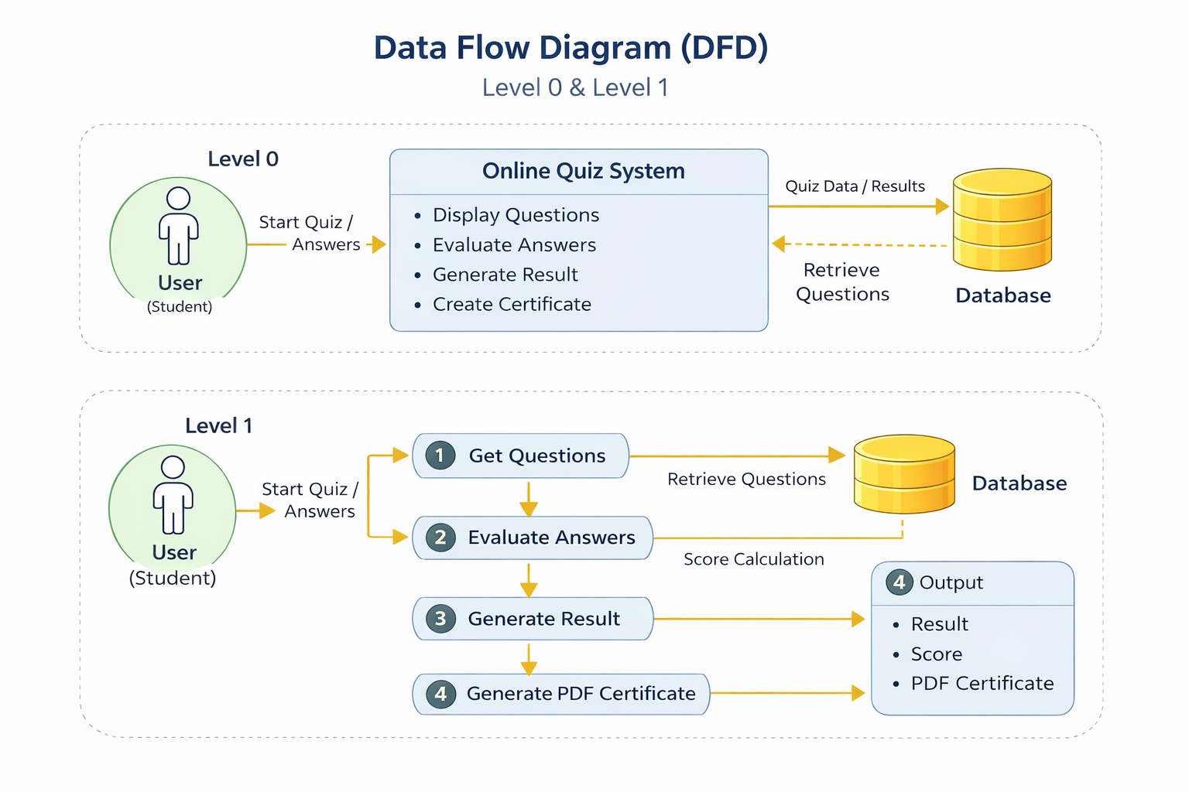
WORKFLOW
1
2
3
4
5
6
7
8
9

Slide 8
TECHNOLOGIES USED
Frontend :
HTML5 – Used to design the structure of quiz pages.
CSS3 – Used to create professional styling and layout.
JavaScript – Handles quiz timer, answer selection, and dynamic page updates.
Backend :
Node.js – Processes quiz data, checks answers, calculates scores, and generates certificates.
Handles communication between frontend and database.
Database :
MySQL – Stores user details, quiz questions, answers, and quiz results.
Tools :
VS Code– Code editor for writing the project files.
Web Browser (Chrome/Edge) – Used to run and test the project.
Hardware Requirements :Computer/Laptop
Software Requirements :
Web Browser (Chrome/Edge)
Code Editor (VS Code)
1
2
3
4
5
6
7
8
9

Slide 9
MODULE DESCRIPTION
Module 1: User Management
Handles user registration and login for accessing the quiz system. It verifies user credentials and stores participant details in the database.
Module 2: Core Processing
Manages quiz questions, options, and correct answers. It displays questions to users and records their selected answers during the quiz.
Module 3: Database Management
Evaluates the user’s answers after quiz completion. Calculates the score and determines whether the user has passed or failed.
Module 4: Reporting & Analytics
Generates a PDF certificate automatically for users who pass the quiz. The certificate includes the user name, score, and completion details.
1
2
3
4
5
6
7
8
9

Slide 10
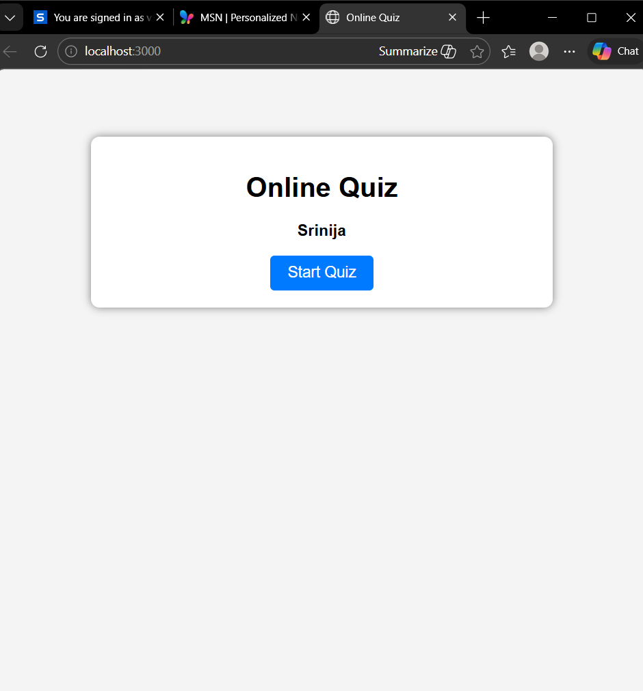
IMPLEMENTATION SCREENSHOTS
1
2
3
4
5
6
7
8
9

Slide 11
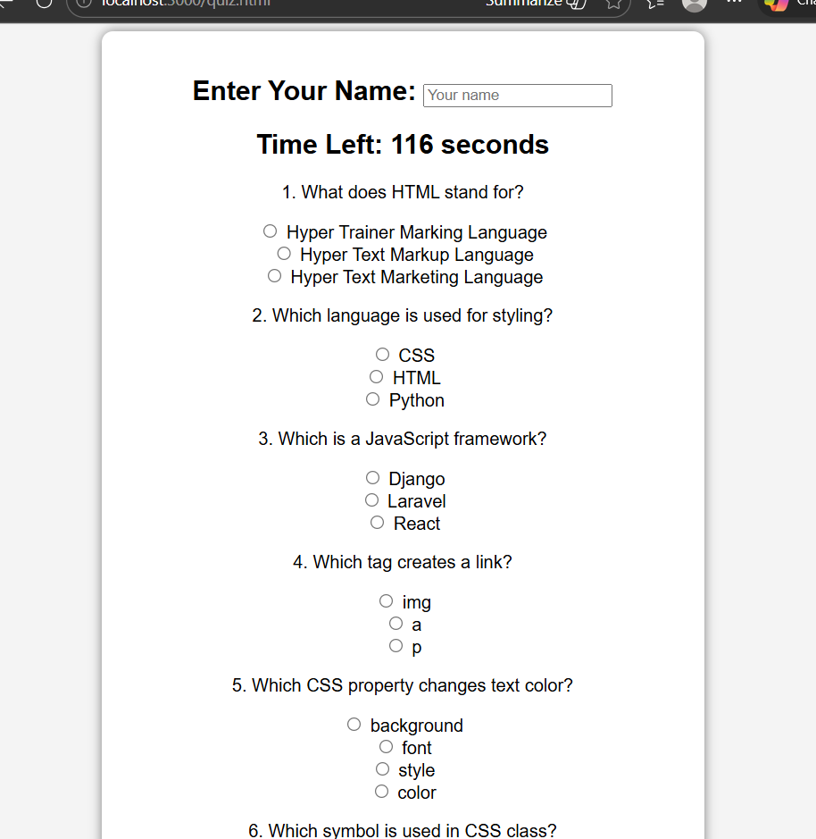
IMPLEMENTATION SCREENSHOTS
1
2
3
4
5
6
7
8(A)
9

Slide 12
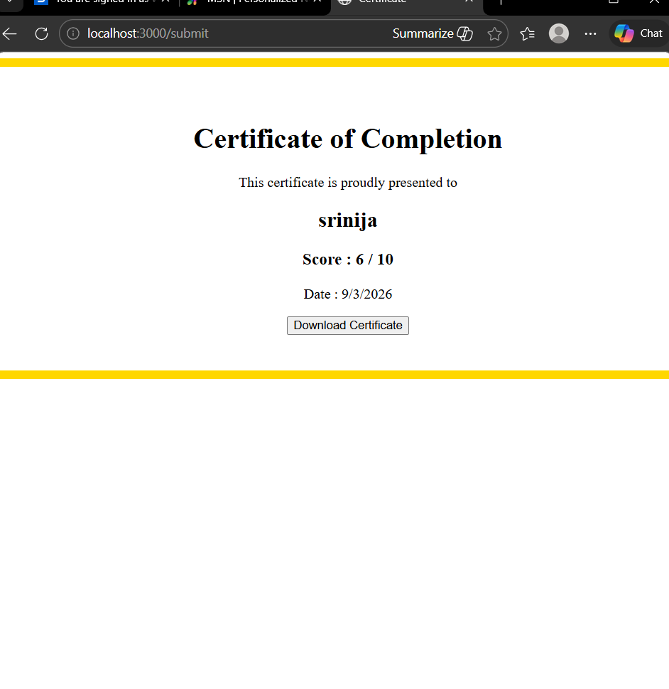
IMPLEMENTATION SCREENSHOTS
1
2
3
4
5
6
7
8(B)
9

Slide 13
.
.
ADVANTAGES & LIMITATIONS
1
Advantages
Automated Evaluation: The system automatically checks answers and calculates scores, saving time and reducing manual work.
Instant Results: Users receive their quiz results immediately after completion.
PDF Certificate Generation: Successful users automatically receive a downloadable certificate.
User-Friendly Interface: Simple interface makes it easy for users to attempt quizzes online.
Efficient Data Management: User data, questions, and results are securely stored in the database.
Limitations
Internet Dependency: Users must have internet access to take the quiz.
Security Risks: Without strong security measures, user data could be vulnerable.
Scalability Issues: The system may require upgrades to support a large number of users simultaneously.
2
3
4
5
6
7
8
9

Slide 14
Thank you

